Slide 1
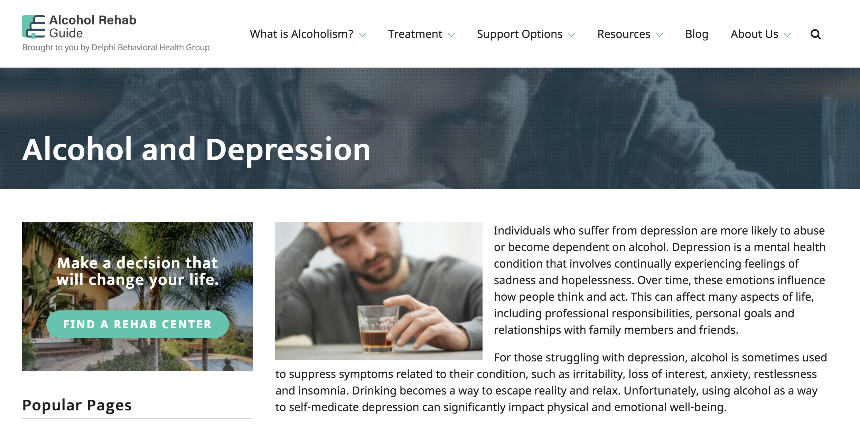
Alcohol Consumption in SF
Team 6: Abderraouf Seghir, Adhish Tripati, Batoor Sayed, Berfin Terzioglu, Edoardo Silli, Minh Tri Dao

Slide 2
Business Problem
We are a consultant team got hired by a startup who is trying to launch a new business in the beverage industry.
We’re trying to understand alcohol consumption patterns in San Francisco.

Slide 3
Ethnicity
Neighborhood
Age

Slide 4
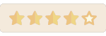

Describe your favorite alcoholic drink?
How often do you drink per week?

Slide 5
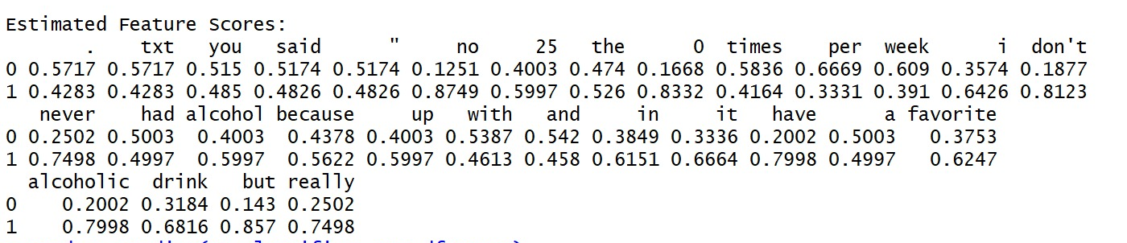
Insights
&
Actions
We saw that people tend to consume alcohol for friendship and joy. On the other hand, there is even a strong relation to sadness and depression.
We believe that alcohol companies need to work on their brand image as advertising through images related to friendship and and they can provide a service to help people in need.

